Slide 1
Job-shop Scheduling
310551166 王柏偉

Slide 2
1
Job-shop scheduling
Introduction, example, methodology
2
Genetic Algorithm
CONTENTS
Introduction, encoding
3
Implementation
4
Evaluation
Correctness and performance
5
Conclusion

Slide 3
1
Job shop scheduling
PART

Slide 4
1 Job-shop scheduling
Introduction
JSP is an is an optimization problem in computer science and operations research.
There are several machines M1,M2, …,Mn, given n jobs J1, J2, ..., Jn of varying processing times, each job consists of a set of operations O1, O2, ..., On which need to be processed in a specific order, each operation has a specific machine that it needs to be processed on and only one operation in a job can be processed at a given time.
We need to schedule the jobs on m machines with varying processing power, while trying to minimize the makespan.
makespan : the length of time that elapses from the start of work to the end.

Slide 5
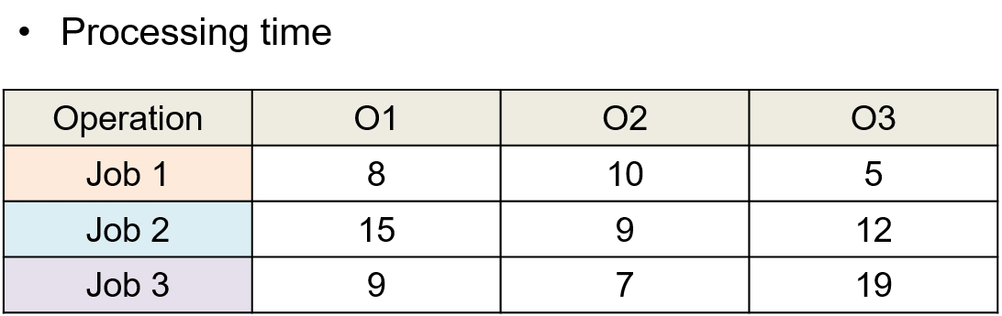
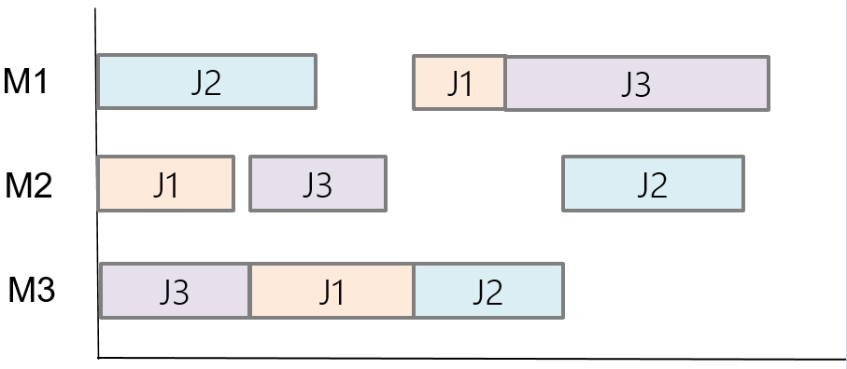
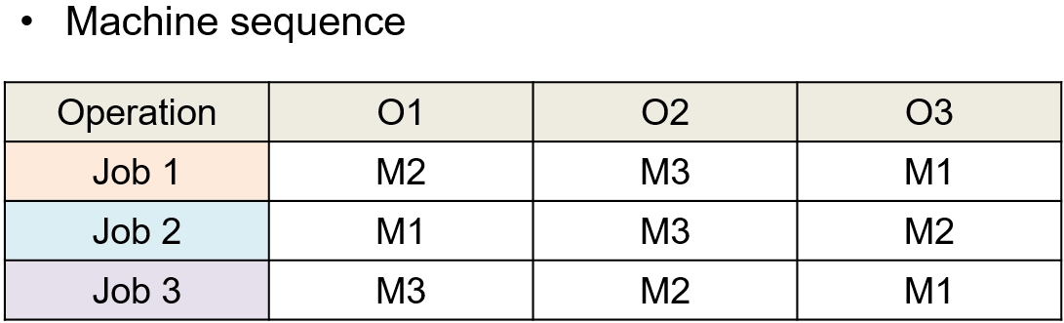
1 Job-shop scheduling
Example

Slide 6
1 Job-shop scheduling
Methodology
JSP is an NP-hard problem, we can use Integral Programming(IP) or Branch and Bound(B&B) to find the optimal solution, but when problem size is no longer small, the efficiency of those algorithm will be low, if we just have ten jobs and ten machines, there are (10!)^10 permutations.
The efficiency of Meta-Heuristic algorithm is much higher than that of IR and B&B, for example genetic algorithm(GA), ant colony optimization(ACO), simulated annealing(SA), but we can just find the near-optimal solution.
I will use the genetic algorithm(GA) to solve the job-shop scheduling.

Slide 7
2
Genetic algorithm
PART

Slide 8
2 Genetic algorithm
Introduction
Genetic algorithm is commonly used to generate high-quality solutions to optimization and search problem by relying on biologically inspired operators such as crossover, mutation, selection, select the best individual.
In GA, a population of candidate solution to an optimization problem is evolved toward solution. Each candidate solution has a set of property(chromosome or gene) which can be mutated and altered.
The evolution usually start form a population of randomly generated individuals, and is an iterative process, with the population in each iteration called a generation. In each generation, the fitness of every individual in the population is evaluated, the fitness is usually the value in the optimization problem we want the solve.
Yes
Near-optimal sequence
Generate
Initial
population
Keep
Best fitness
N times
?
No
crossover
mutation
calculate fitness
selection

Slide 9
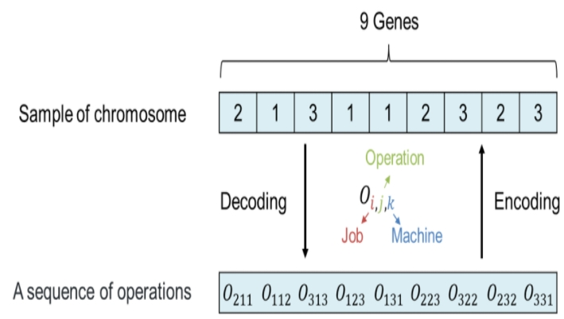
2 Genetic algorithm
How to encode our jobs to genes
Oijk represent the job i is processing j on kth machine

Slide 10
3
Implementation
PART

Slide 11
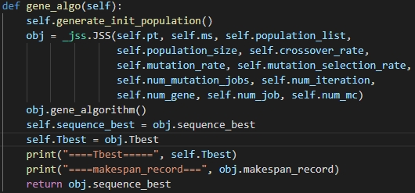
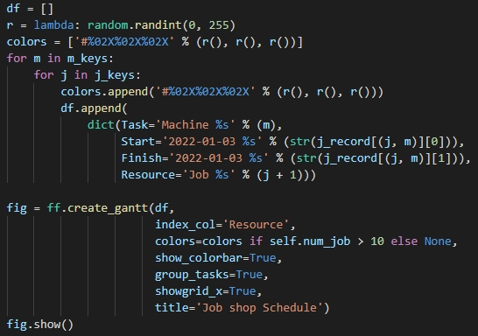
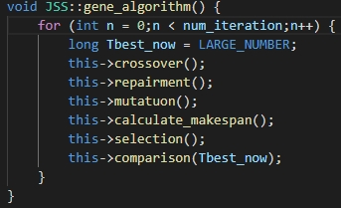
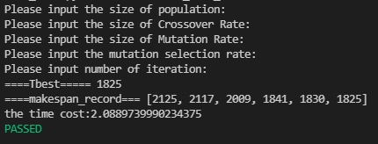
3 Implementation
1. Initialize the parameter
Population size = 30
Crossover rate = 0.8
Mutation rate = 0.2
Mutation selection = 0.2
Number of iteration = 2000
2. Create gene algorithm instance
3. Plot the Gantt chart
Python
Python
Python
C++

Slide 12
4
Evaluation
PART

Slide 13
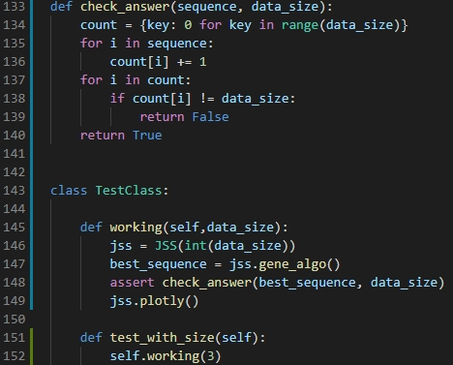
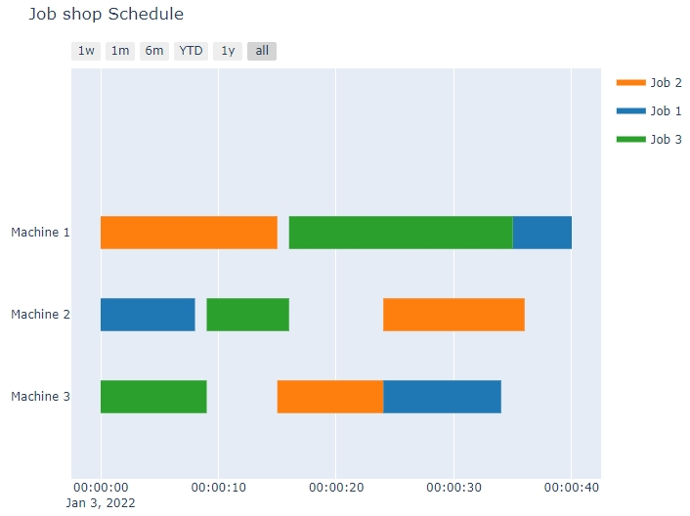
Evaluation 4
Correctness
Output sequence
Gantt chart

Slide 14
Evaluation 4
Performance
Job size=3 & machine size=3
Iteration times
1
5
10
Time cost
0.0018s
0.002s
0.005s
Record of makespan
40
40
40

Slide 15
Evaluation 4
Performance
Job size=10 & machine size=10
Iteration times
10
100
1000
10000
100000
Time cost
0.009s
0.046s
0.41s
4.08s
41.07s
Record of makespan
1455, 1411
1348, 1337, 1322
1407, 1402, 1393, 1386, 1381, 1327, 1322, 1268
1365, 1334, 1308, 1255, 1243, 1212
1463, 1439, 1366, 1336, 1327, 1307, 1269, 1252, 1220, 1193, 1185 , 1173

Slide 16
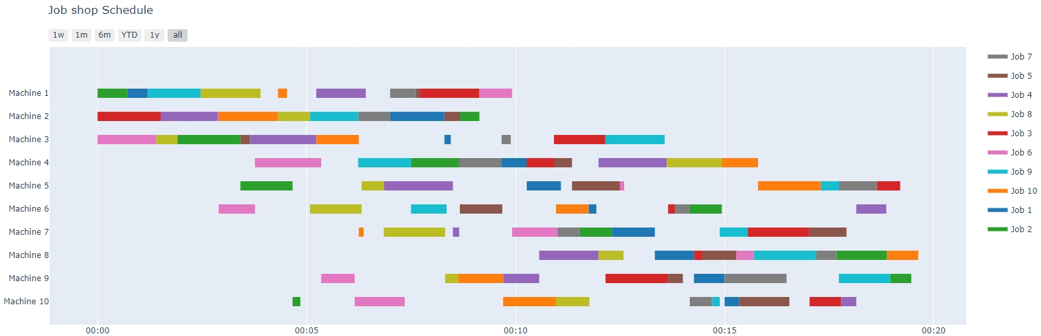
Evaluation 4
Performance
Job size=10 & machine size=10

Slide 17
Evaluation 4
Performance
Job size=15 & machine size=15
Iteration times
10
100
1000
10000
100000
Time cost
0.21s
0.12s
1.06s
10.55s
106.21s
Record of makespan
2030, 2015
1930,1911,1889
1932,1916,1898,1863
2080,2069,2063,2056,1918,1900,1881,1864,1796,1766,1757
2025, 1961, 1937, 1902, 1879, 1861, 1852, 1842, 1793, 1778, 1723, 1713, 1683

Slide 18
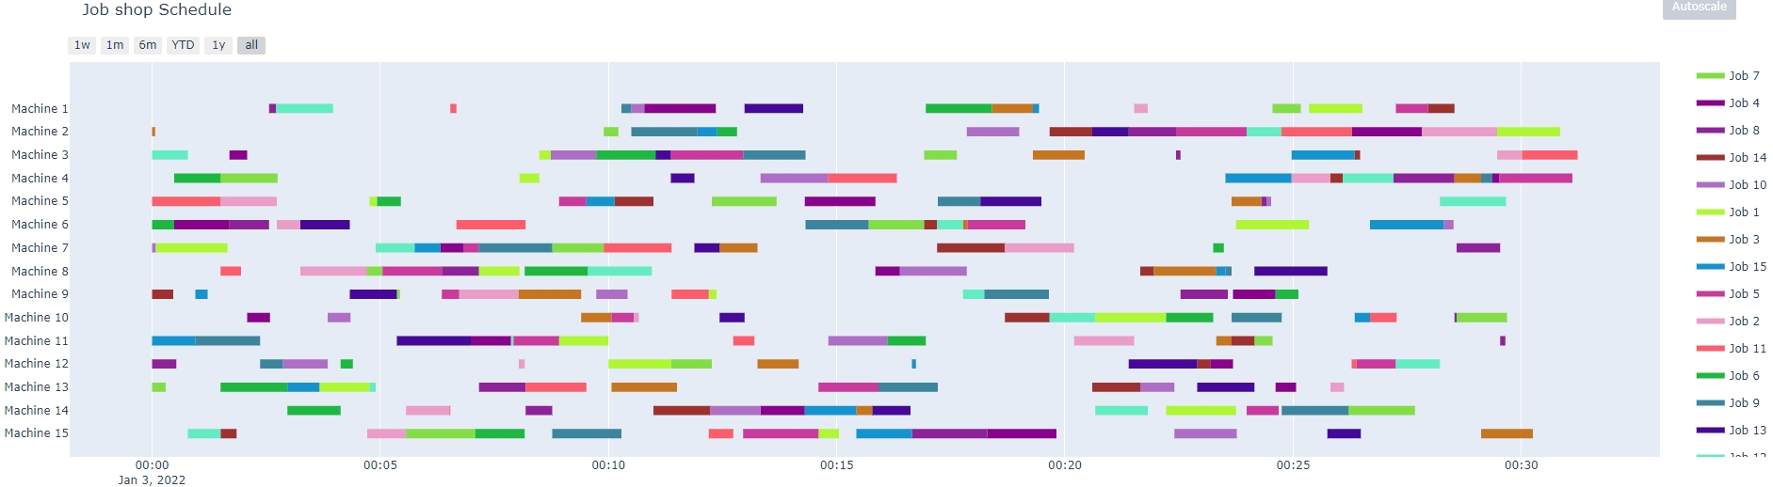
Evaluation 4
Performance
Job size=15 & machine size=15

Slide 19
5
Conclusion
PART

Slide 20
5 Conclusion
Job-shopping is a NP-hard problem, so the complexity will increase a lot although the data size only rise slightly.
Heuristic algorithm is a way to find a near-optimal solution efficiently, so we choose Genetic-algorithm to solve the job-shop scheduling.
Our implementation shows that the record of makespan is a convergence sequence, it succeeds to find a near-optimal solution with a given iteration times.

Slide 21
THANKS

